Slide 1
Why Snowflake? Cloud Data Warehousing?
Notes:
Prerequisites:
"Basic knowledge of SQL, and database concepts and objects“.
"Familiarity with JSON semi-structured data".

Slide 2
Agenda
Demystify what makes a (cloud) Data warehouse different by its core architecture from Database, Data Lake.
Cloud data warehouse.
What is Snowflake?
Why Snowflake?
Live demo - Auto inject Twitter data into Snowflake using Snowpipe and do real-time analysis in Power BI.

Slide 3
Database Data warehouse Data Lake
- Demystify.
- Best fit scenarios to choose one.
Notes:
This is a crazy and slightly confusing time in the data architecture space. More and more companies are shifting towards data lakes, yet the traditional data warehouse and database continues to provide value, as it has for decades. Now to add that, we have this increasingly popular lakehouse and delta lake concept. The concepts I discuss here will be common that would fit for deciding over data services in Azure as well.

Slide 4
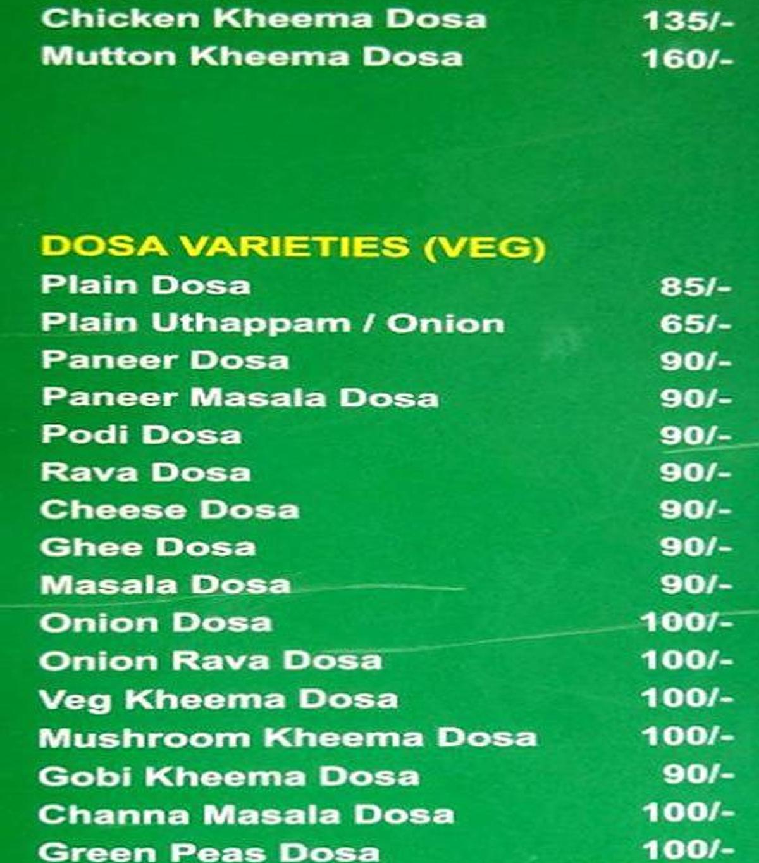
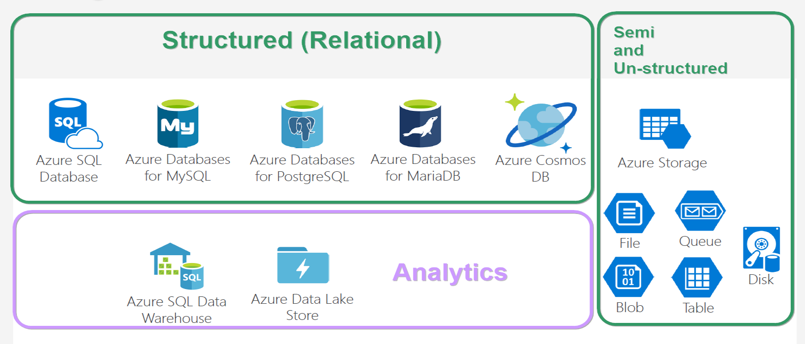
Database VARITES
Notes:
And looking at this, does both give same feeling? ☺

Slide 5
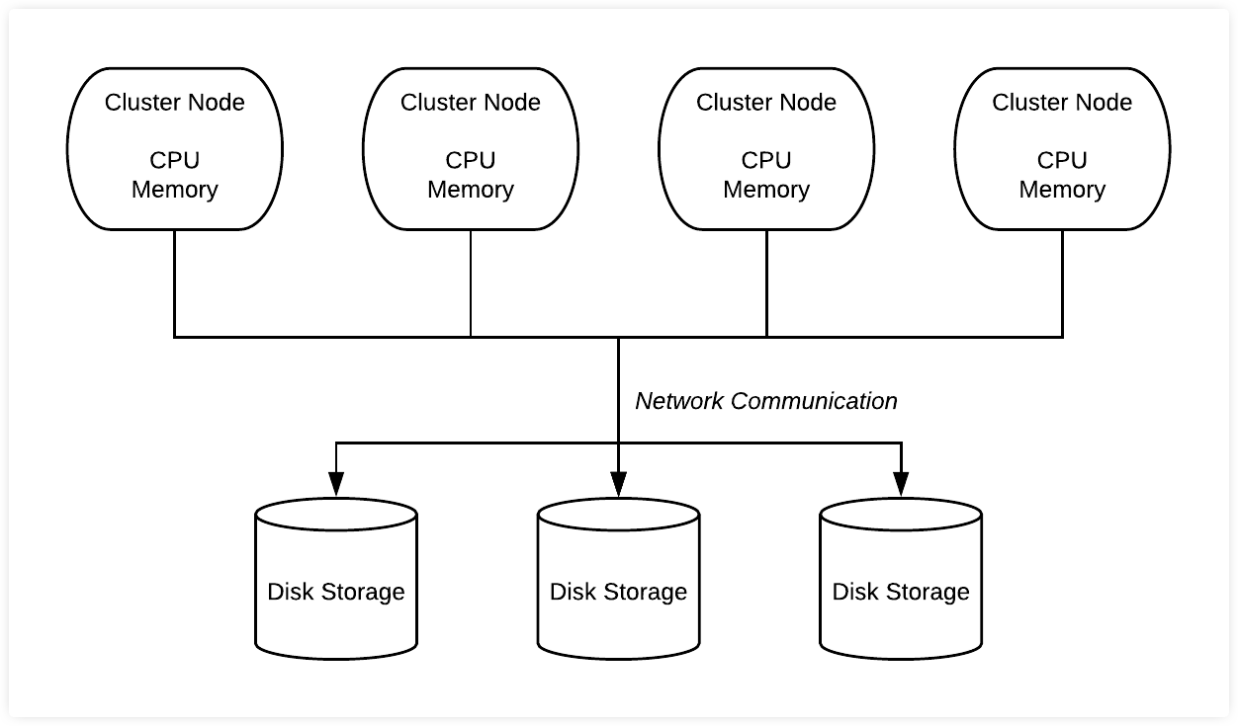
Database
* Co-location of Compute & Storage.
* Schema on Write.
* Recommended for,
- Structured data of less than a TB,
- Purpose - OLTP.
* Not recommended for,
- Ad-hoc analytics.
- More dependency in sharding.
Notes:
Size is not an issue as per a database’s doc. But generally not used for big data.
OLAP cubes are possible in RDBMS, but it need to be prepared before analytics. Which is what I mean for ad-hoc.

Slide 6
DBMS storage models
Notes:
NoSQL db – data storage model types –
* Document - Frequent schema changes with sub-tables need. (Mongo DB)
* Graph – Neo4j.
* Key-value - Redis.
* Column-oriented – Hbase, Cassandra.

Slide 7
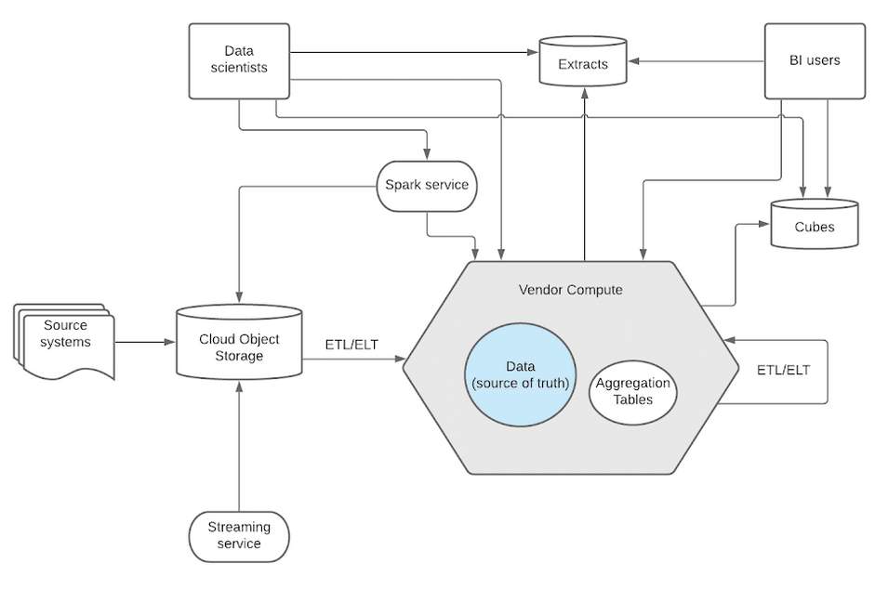
Data Warehouse
* Separation of Compute & Storage.
* Schema on Write.
* Recommended,
- If you know metadata & schema/format of analytics to be done.
- Decided that ML/AI not needed much;
- Expose out; allowing customers to analyse.
* Not recommended,
- Unstructured data like image and video.
- Semi-structured with multiple levels.
Notes:
* Data will be converted to proprietary software’s format. While leaving out, the vendor will export it to a common format like parquet or ORC.
* Image - Snowflake has a data type called ‘BINARY’. Still not recommended. Rather you can decide to store the URL that points to that image/video stored in data lakes like S3.

Slide 8
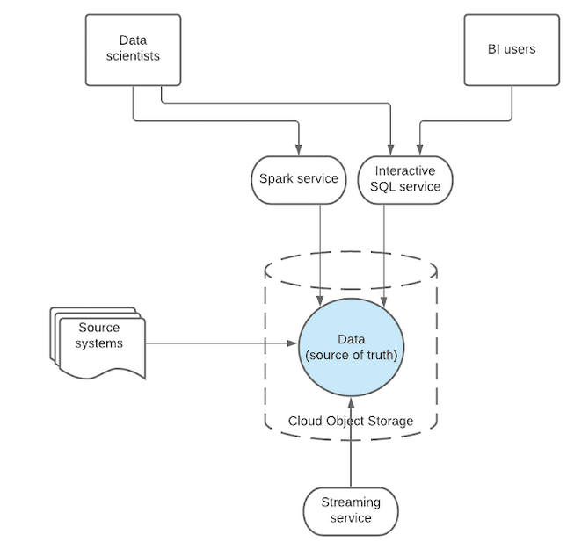
Data Lake
* Separation of Compute & Data.
* Schema on Read.
* Recommended when,
- Have all types of data of any size.
- Store now but have no immediate plan about analytics.
- Internal analytics – dump all; play as and when you need.
Not recommended when,
- Data stored should be readily available for analytics upon which users would create reports.
Notes:
* There wont be any conversion or hard-copying between systems. Data relies in 1 single place and all external systems access over same data. So data democratization is good while using data lake.

Slide 9
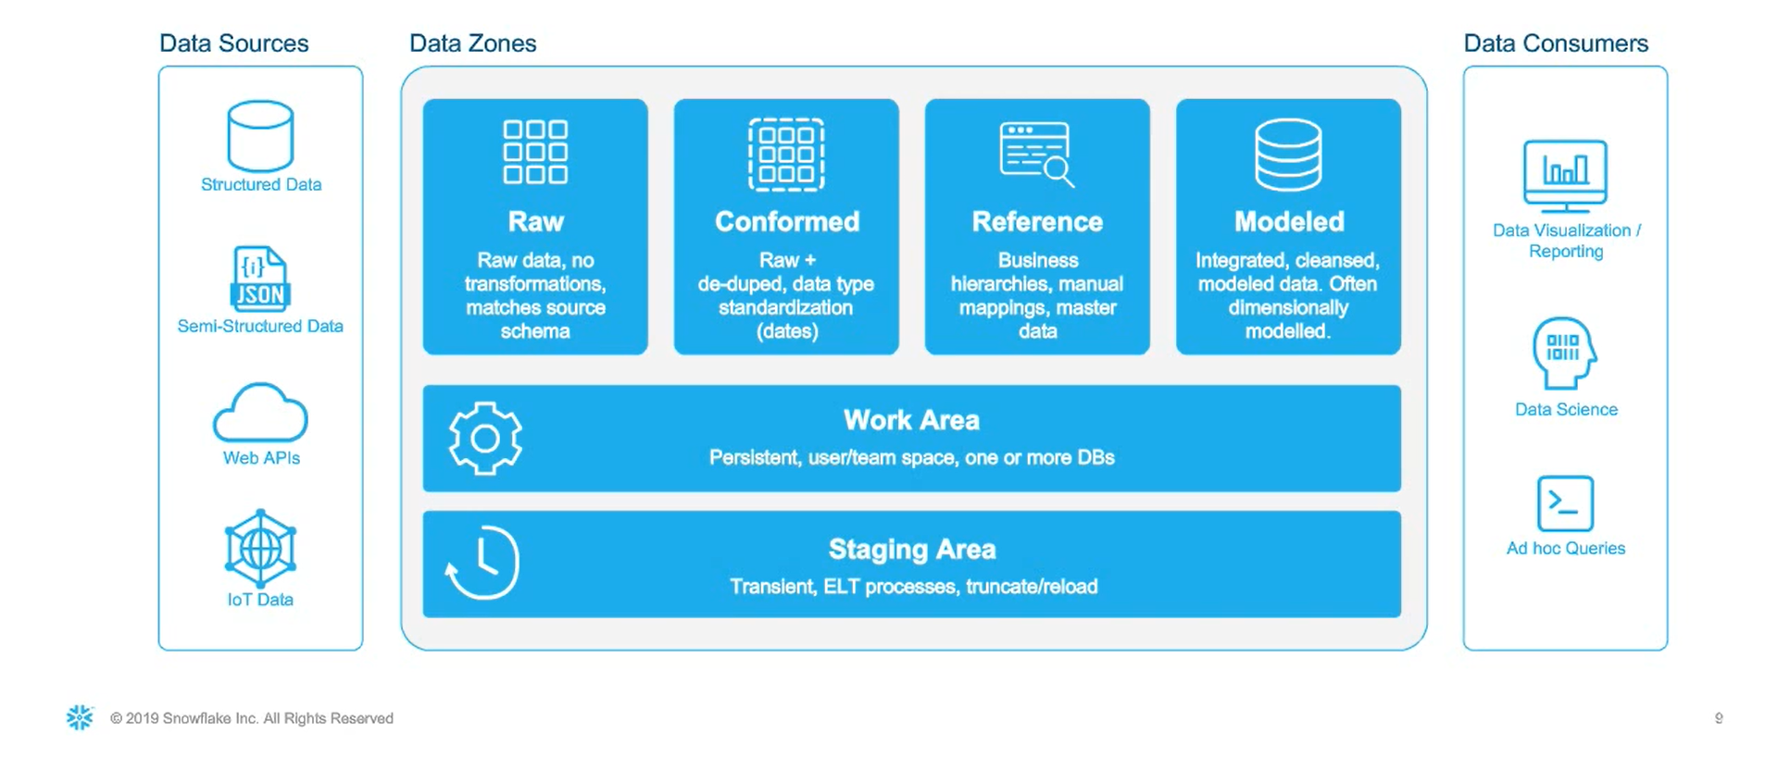
HYBRID Data architecture
Notes:
Different use cases of analytics - Data science is one part of it. Data analytics is the major part.

Slide 10
Cloud data warehouse
* Amazon Redshift
* Azure SQL Data warehouse (Azure Synapse Analytics)
* Snowflake
* Google BigQuery

Slide 12
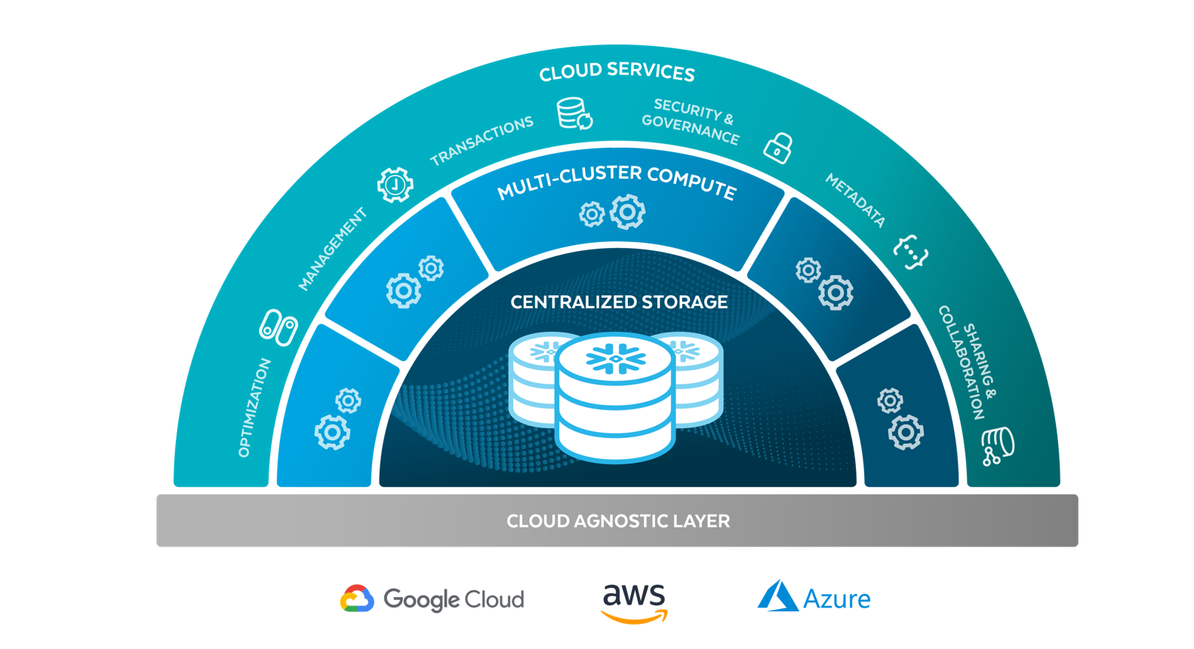
Snowflake ARCHITECTURE

Slide 13
Components used in demo
* Snowpipe - Serverless concept for data loading instead of using VWH + copy command in SF itself.
* Zero Copy Cloning - Prod/Dev/Test - Assign cloned tweets_test table to testing team.
* Analyse semi-strcutured data like json, avro, parquet.
* Fast auto scaling.
* Schema on read via variant datatype.
* Time travel.
Notes:
Traditional data warehouses cannot do these things easily.

Slide 14
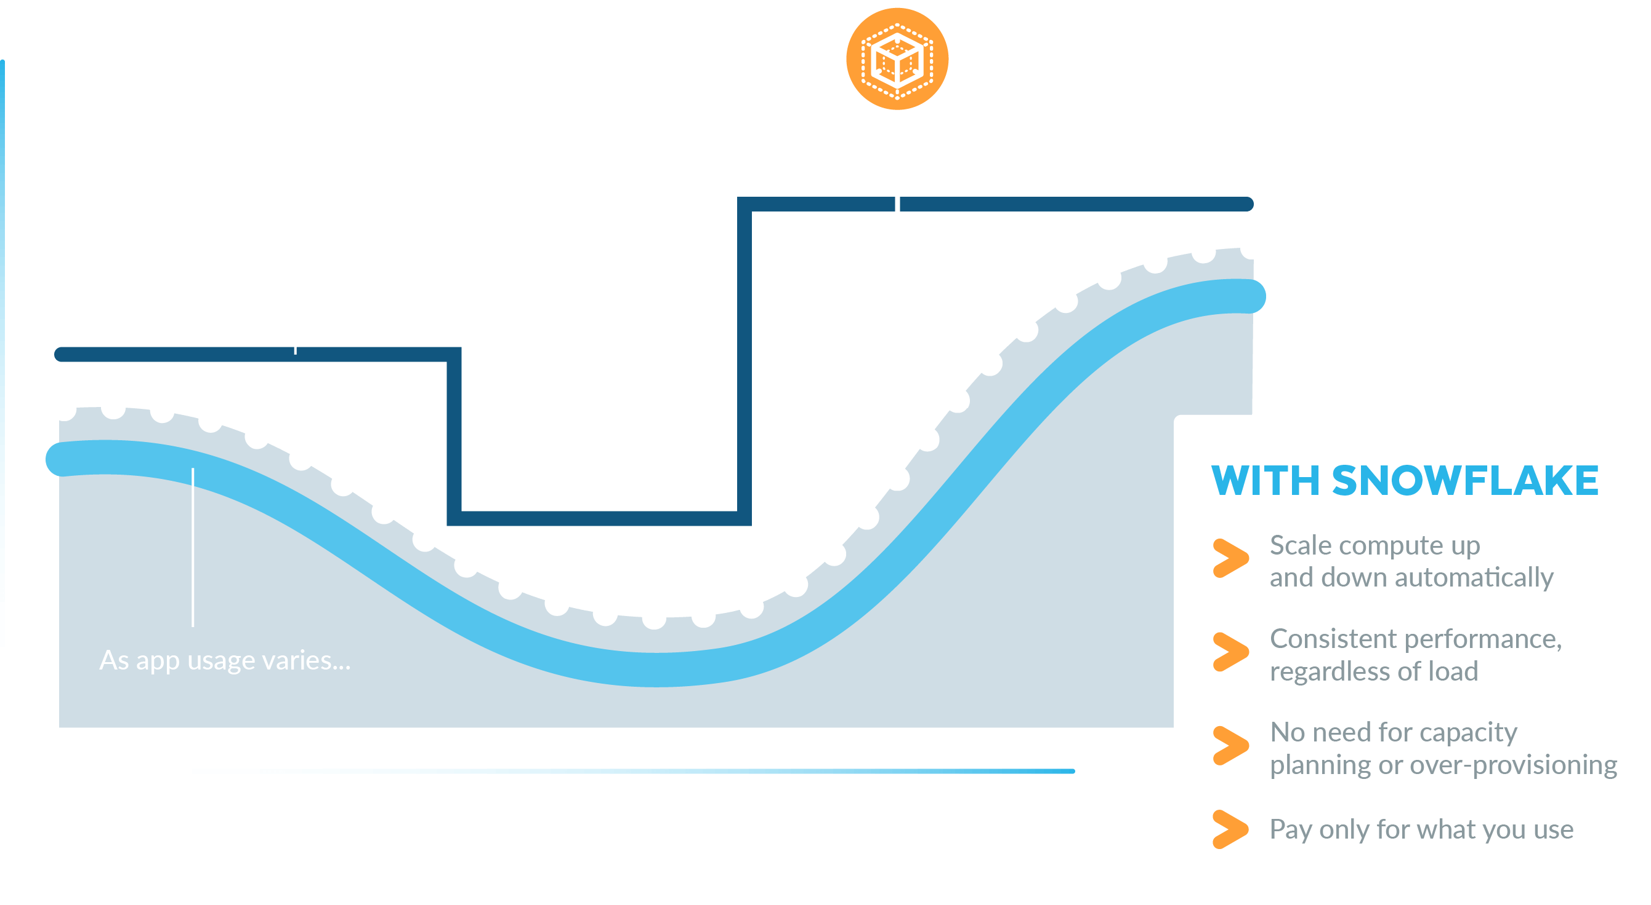
Auto scaling

Slide 15
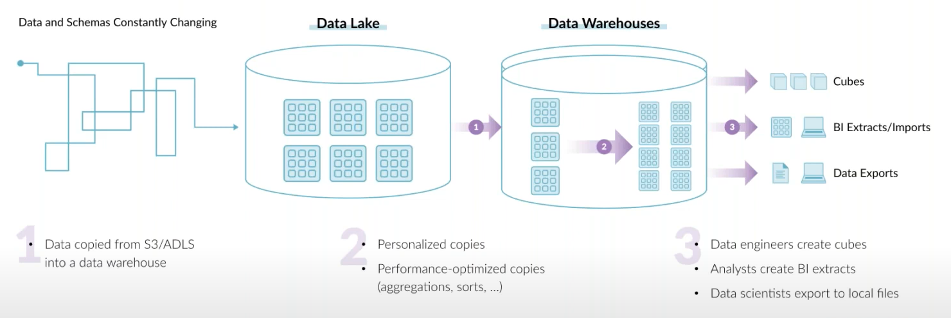
End goal of a data architecture
* Architect so that copying data gets lesser across teams.
* Allow USER to take SMART decisions.
* Define goal based on customers need.

Slide 16


https://www.linkedin.com/in/dinesh-kumar-prabakaran
Thank you
Questions?

